Slide 1
Productive Crop Fields Dataset
Proposal of limited dataset sharing with scientific community

Slide 2
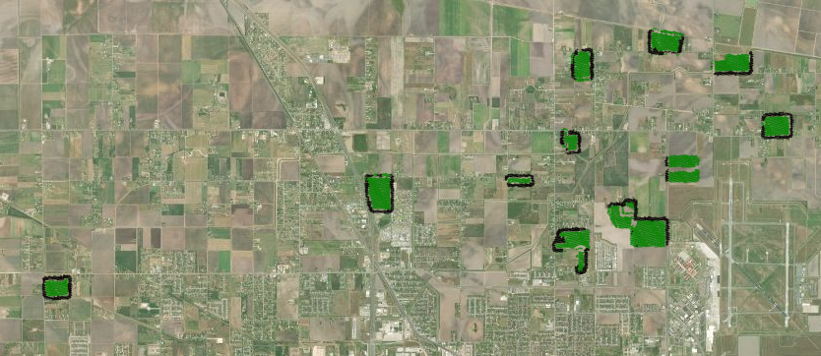
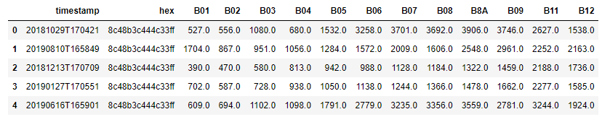
Data contained in the dataset
No confidential information in any feature
Description: The time, location and satellite spectral values of corn crop areas in USA.
Fields: 17
Customers: 1
Productivity data shared: No
Machine data shared: No
Dates: From Oct/2018 to Sept/2019

Slide 3
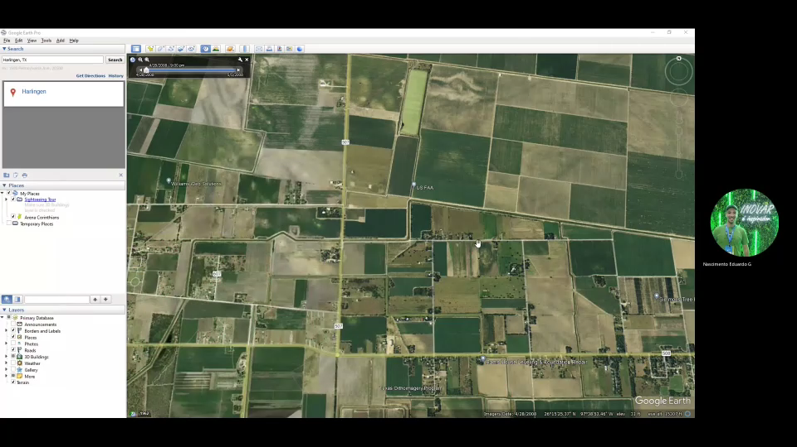


Detection of Fields using freely available map tools
Identification of productive crops by navigating satellite image dates
Why are we not doing it manually?
Manually collected data will artificially represent this data but would not achieve the same challenges that machine-built has and that we want to overcome.

Slide 4
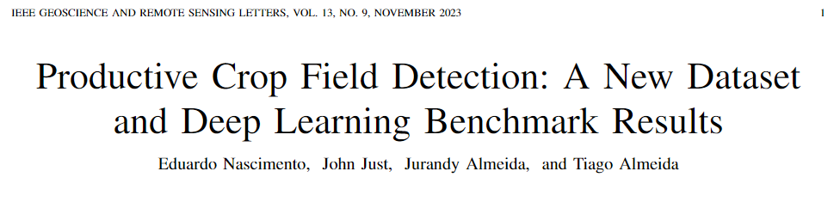
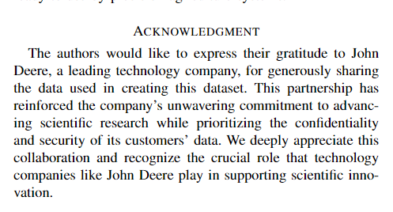
Acknowledgement
Should we include a gratitude note in the paper?
ONLY if contributes to the company’s goal to be recognized as a high-technology company which could have, as far as we understand, positive outcomes on talent acquisition and academic recognition.

